Slide 1
Elandsdrift and DeMistkraal Weir Operation: River Release

Slide 2
Elandsdrift: Normal Operations
Minimum release of 1.5 m³/sec
Weekly variable release for irrigation demand
Objective:
Compare the Actual Release (Q5H007) vs Irrigation Demand + 1.5 m³/sec
Compare Sheldon Flow vs. 2-4 m³/sec target range
Exclude periods of flood releases and when filling Glen Melville Dam

Slide 3
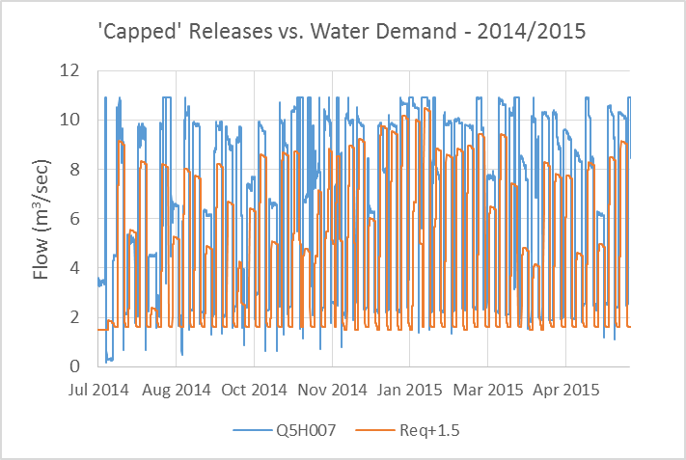
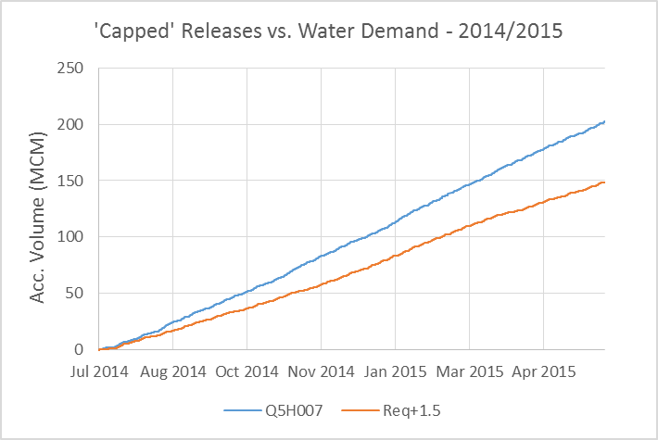
2014 / 2015 Water Year
Minimum release often 2 m³/sec, rather than 1.5 m³/sec
In general, the release (blue line) is more than the demand + 1.5 m³/sec
Release does change with different request volumes, but often release is still too high
Accumulated difference over 1 year ~ 50 MCM

Slide 4
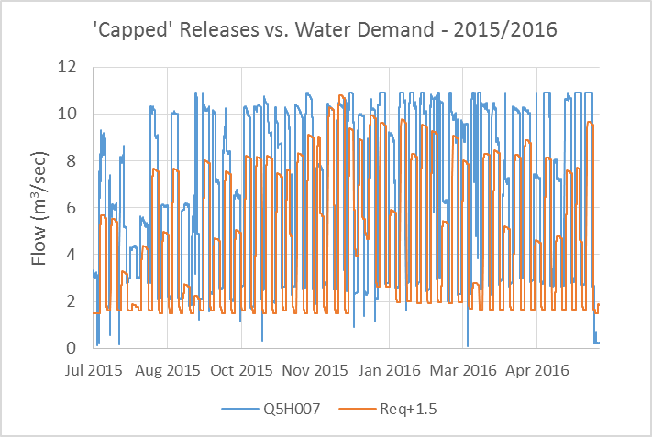
2015 / 2016 Water Year
Similar findings compared to previous year
Again, accumulated difference over 1 year ~ 50 MCM

Slide 5
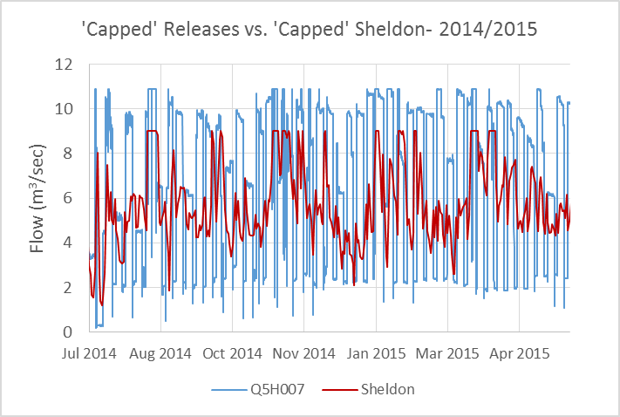
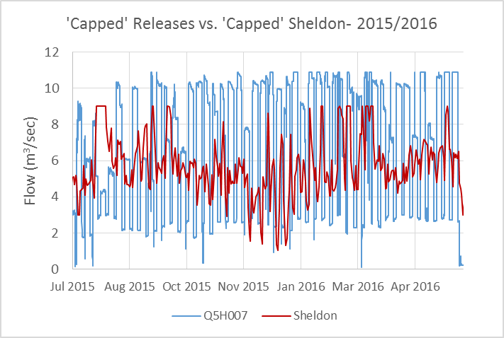
Flow at Sheldon
Flow at Sheldon is target range of 2 – 4 m³/sec

Slide 6
DeMistkraal: Normal Operations
Constant release of 1.0 m³/sec
Objective:
Compare the Actual Release (Q8H006) vs Irrigation Demand + 1.0 m³/sec
Exclude periods of spill
Example analysis for 2015 / 2016 water year

Slide 7
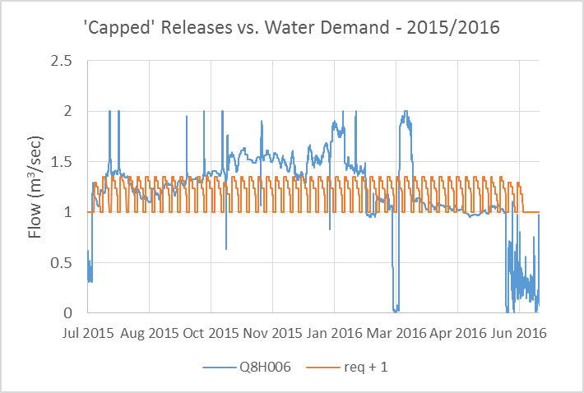
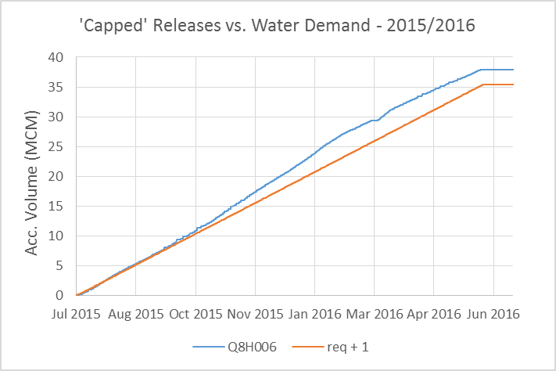
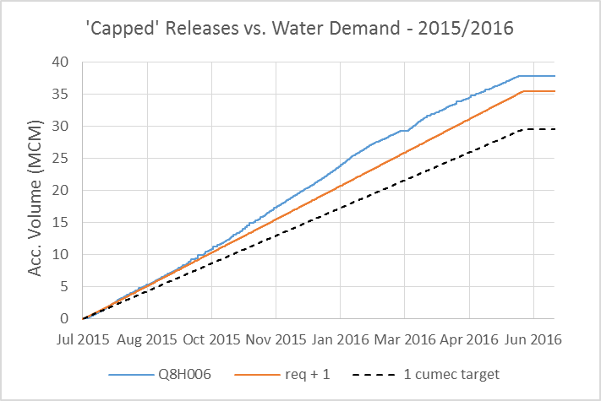
2015 / 2016 Water Year
Release very variable relative to defined target of 1.0 m³/sec
Initial difference shows actual release versus request + 1.0 cumec
Compare Actual vs target of 1.0 cumec
~7 MCM more released than target
Similar result to 2014 / 2015 water year

Slide 8
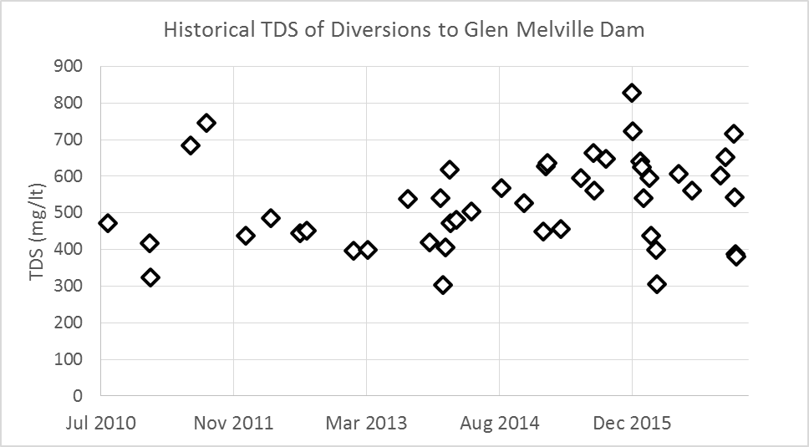
Historical diversions to Glen Melville Dam (2010 – 2017)
Total volume transferred ~ 90 MCM
47 separate transfer events
Average TDS of all water transferred 510 mg/lt

Slide 9
Summary of Glen Melville Dam Transfers (2010 – 2017)
TDS of transfer is good
Majority of transfers coincide with tributary flows
Majority of tributary flow events were used ▪
During the August / September periods, there were 3 years when a release was required to fill Glen Melville dam, when no tributary water was available (due to low capacity of Glena Melville relative to demands)

Slide 10
Apparent missed opportunities to divert water
Summary of apparent missed opportunities to divert water (for 600 mg/lt threshold).
2 events in 2010 water year (Nov, Dec)
4 events in 2012 water year (Oct, Nov, Dec, Mar)
1 event in 2013 water year (Dec)
1 event in 2014 water year (Dec)

